Slide 1
Applications of Downscaling in Assessing Impacts of Climate Change: Challenges and Unanswered Questions
Subimal Ghosh
Department of Civil Engg. and IDP in Climate Studies
IIT Bombay

Slide 2
Downscaling
Impacts Assessment
Drought Analysis
Agricultural Management
Water Demand Availability Analysis
Water Resources Management
Hydraulic Structure Design
Ecological Impacts
Risk and Vulnerability Assessment of Extreme Events
Regional Scale Hydro-meteorologic Variables, e.g., Rainfall in a city
GCM
Output
Large Scale Climate Variables
Downscaling
Statistical Downscaling
Dynamic Downscaling

Slide 3
General Framework
Uncertainty
GCM Output (Large Scale Climate Variables)
Multiple GCMs, ensemble and scenarios
Downscaling
Local Meteorological variables
Multiple Land use projections
Hydrologic Models
Land Use Change
Hydrologic Variables in a River Basin
Hydrologic Model Uncertainty
Future Hydrologic Scenario in River Basin
Water Resources Planning and Adaptation

Slide 4
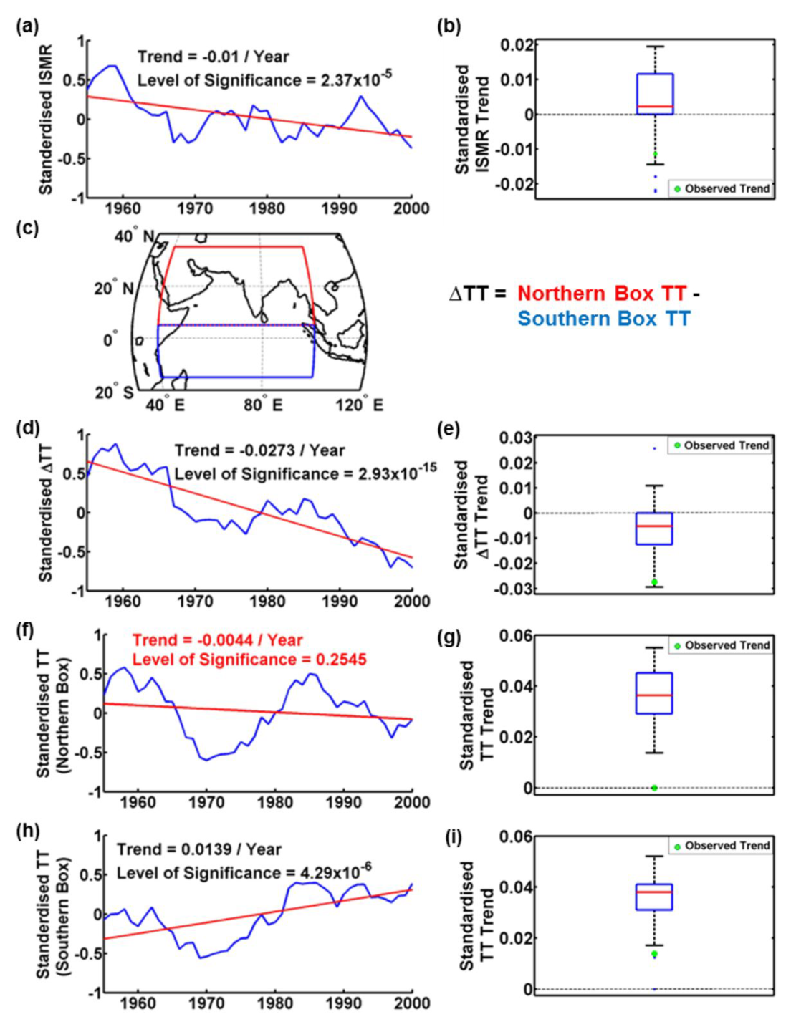
Can GCMs simulate observed trend?
Even if you consider Multi-Model Average → it will give opposite trend
Saha et al. (2014), GRL

Slide 5
CORDEX Models are great but may need Improvements
Singh et al. (2016)
Climate Dynamics

Slide 6
What about statistical downscaling?
Standard Approach
Predictor 1
Predictor 2
Statistical Relationship
Predictor 3
Predictor 4
Predictand
Impact relevant climate variable
Predictor n

Slide 7
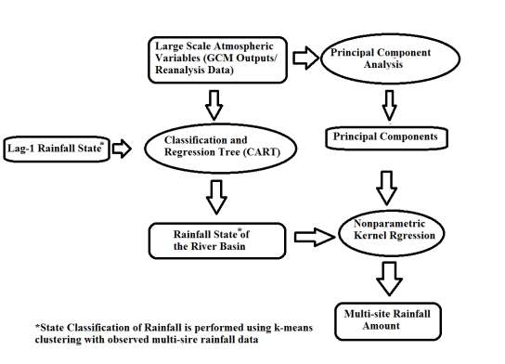
Our Approach
Kannan and Ghosh (2013), WRR

Slide 8
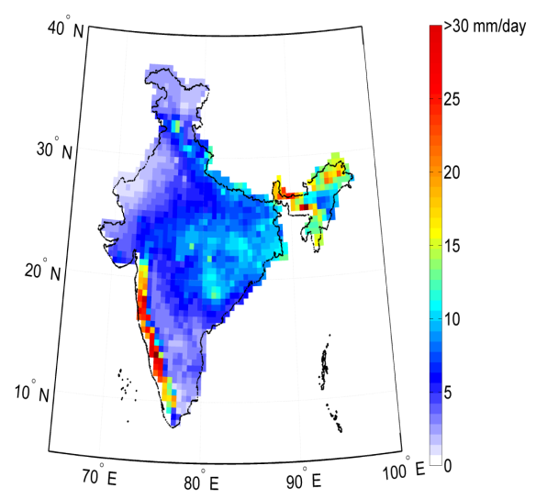
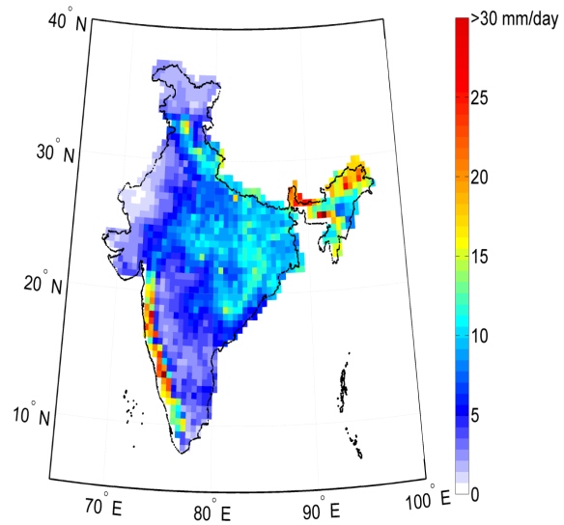
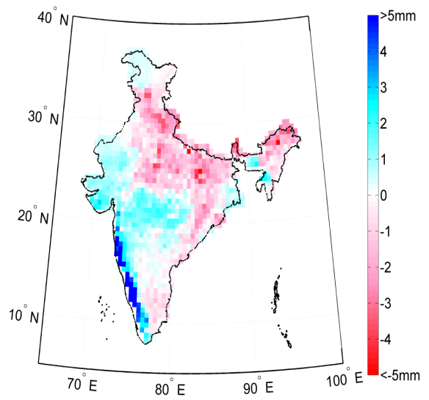
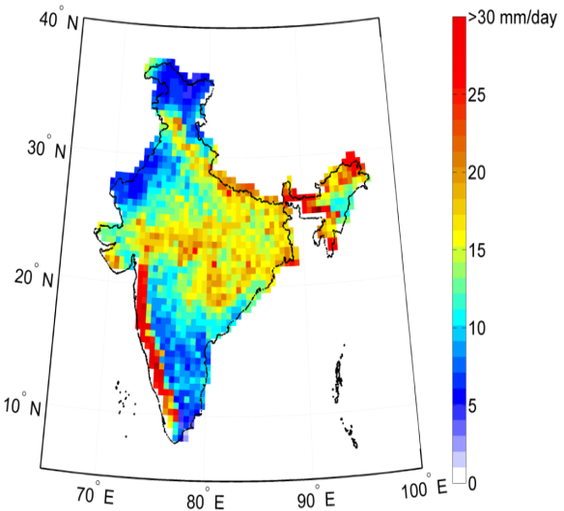
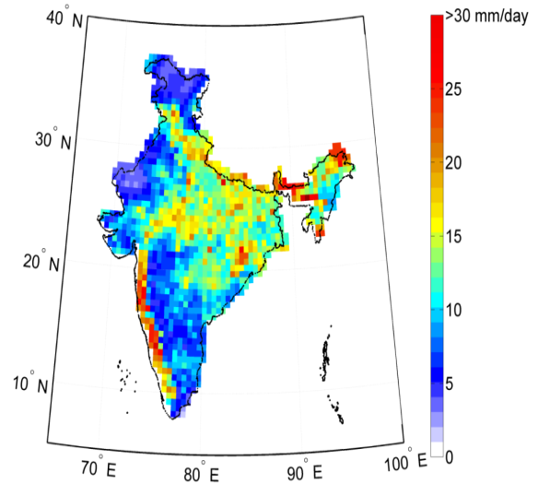
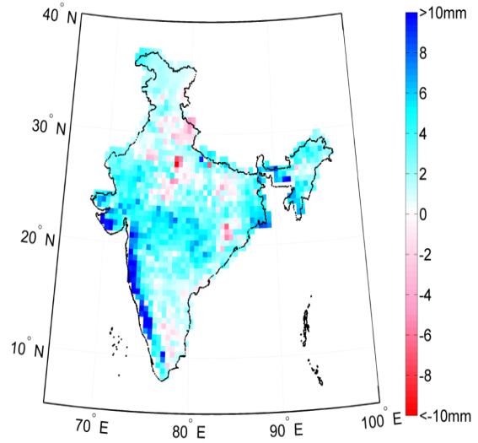
Historic Period Simulations: Comparison of Statistical Properties (1971-2000)
Observed Mean rainfall
Projected Mean rainfall
Difference in mean (mm/day)
Salvi et al.
(2013)
JGR
13
Observed rainfall standard deviation
Observed rainfall standard
deviation
Difference in standard deviation (mm/day)

Slide 9
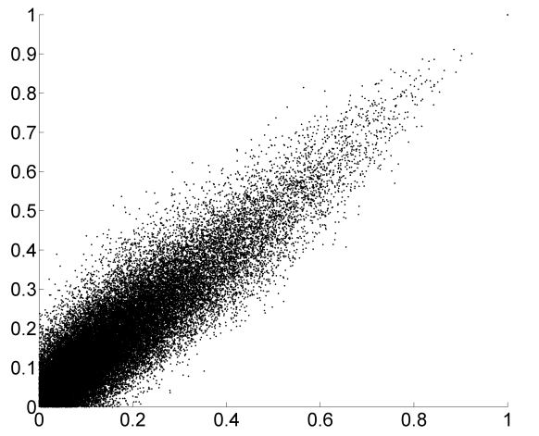
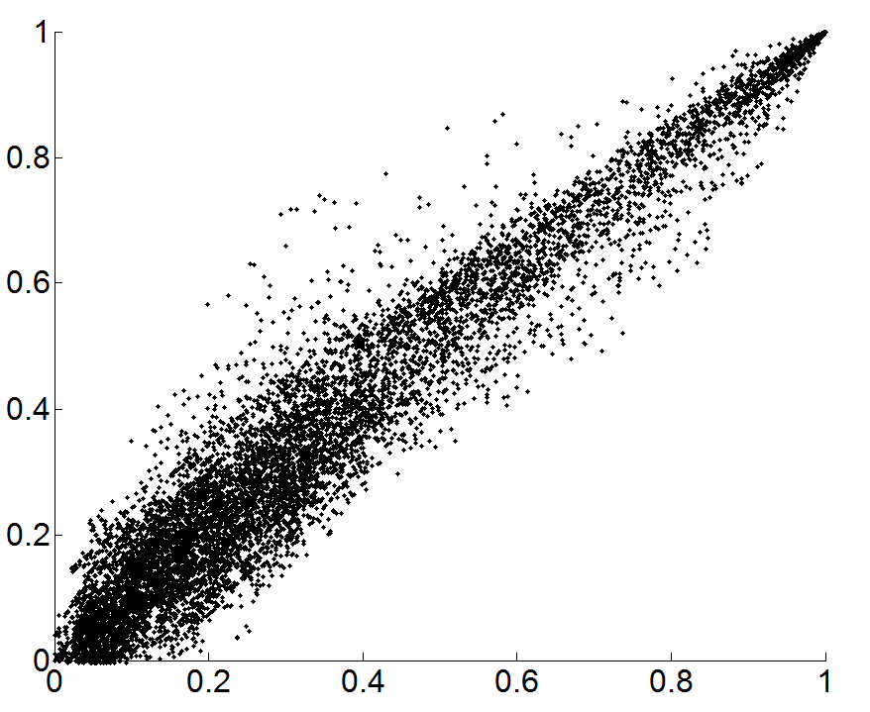
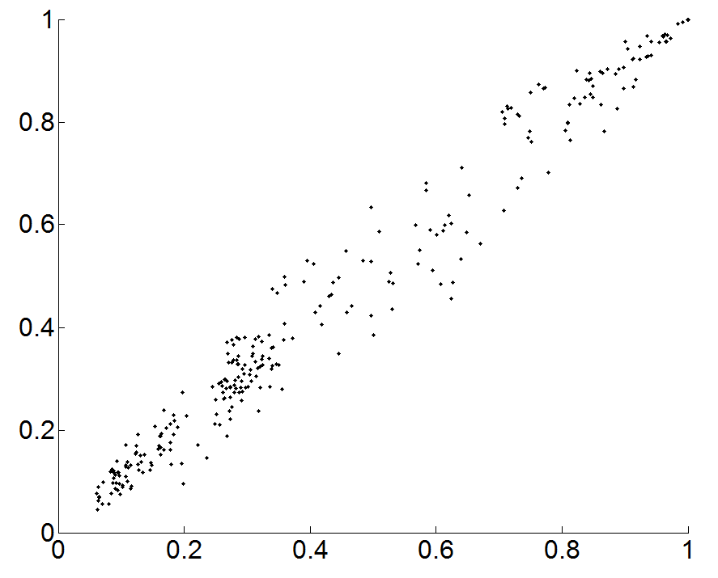
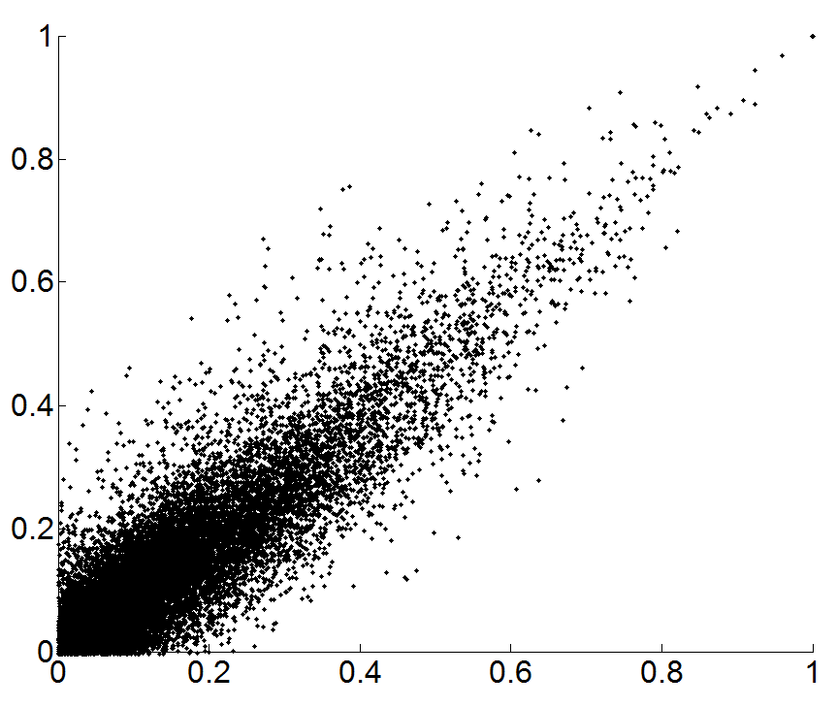
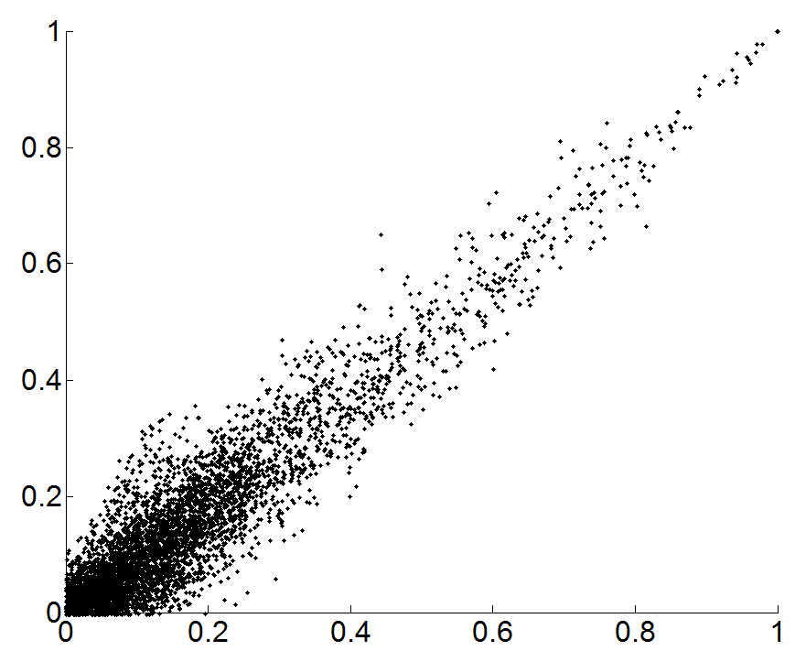
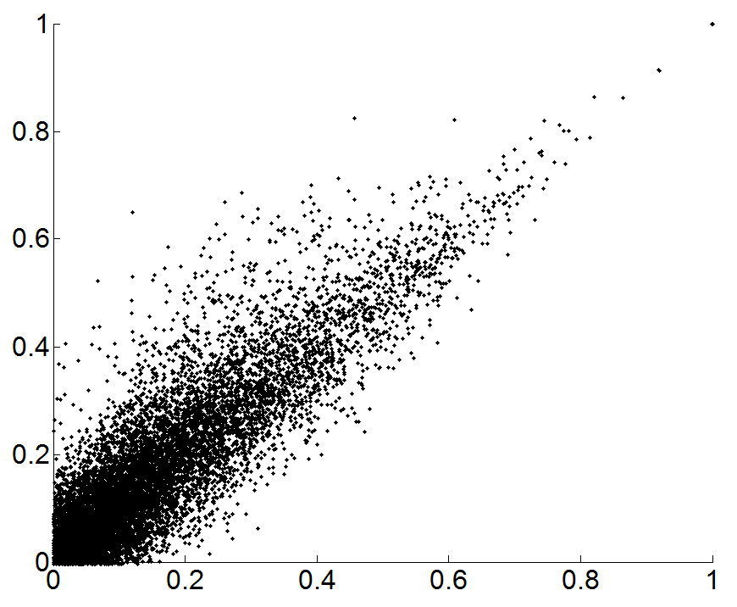
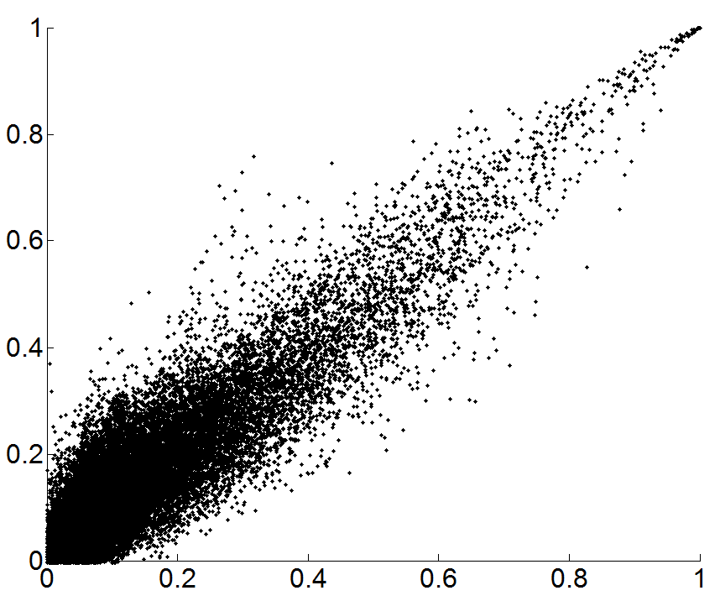
Zone-Wise Cross-correlation plots
Central
JnK
North East Hills
North
North East
Cross-correlation for observed data on X axis
Cross-correlation for simulated data on Y axis
South
West
14
Notes:
Fig. 9: Zonewise cross-correlation plots

Slide 10
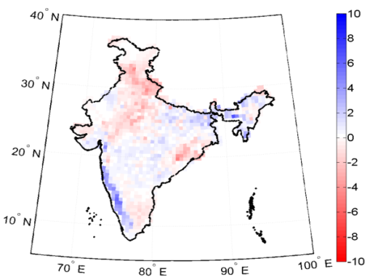
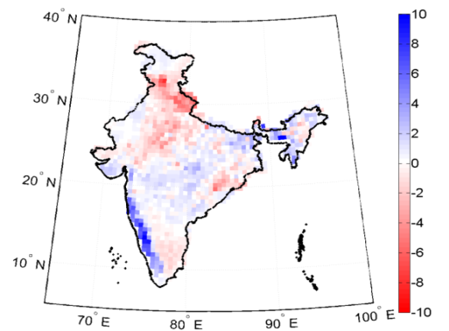
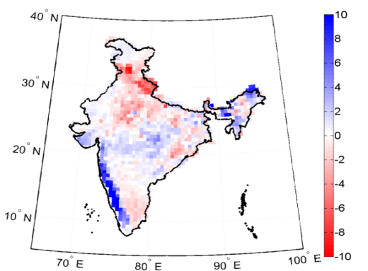
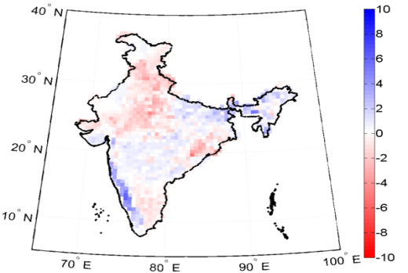
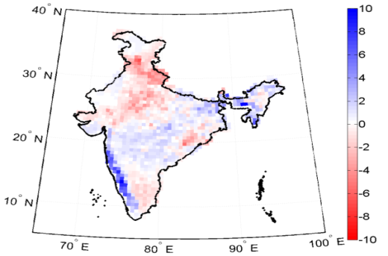
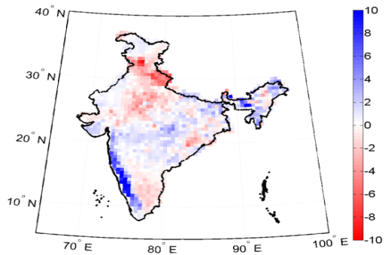
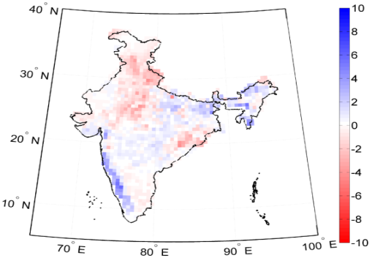

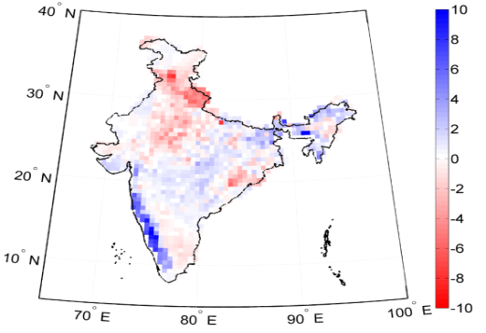
Future Projections
2010-2039
2040-2069
2070-2099
A2
All Dimension are in mm/day
A1B
B1
15

Slide 11
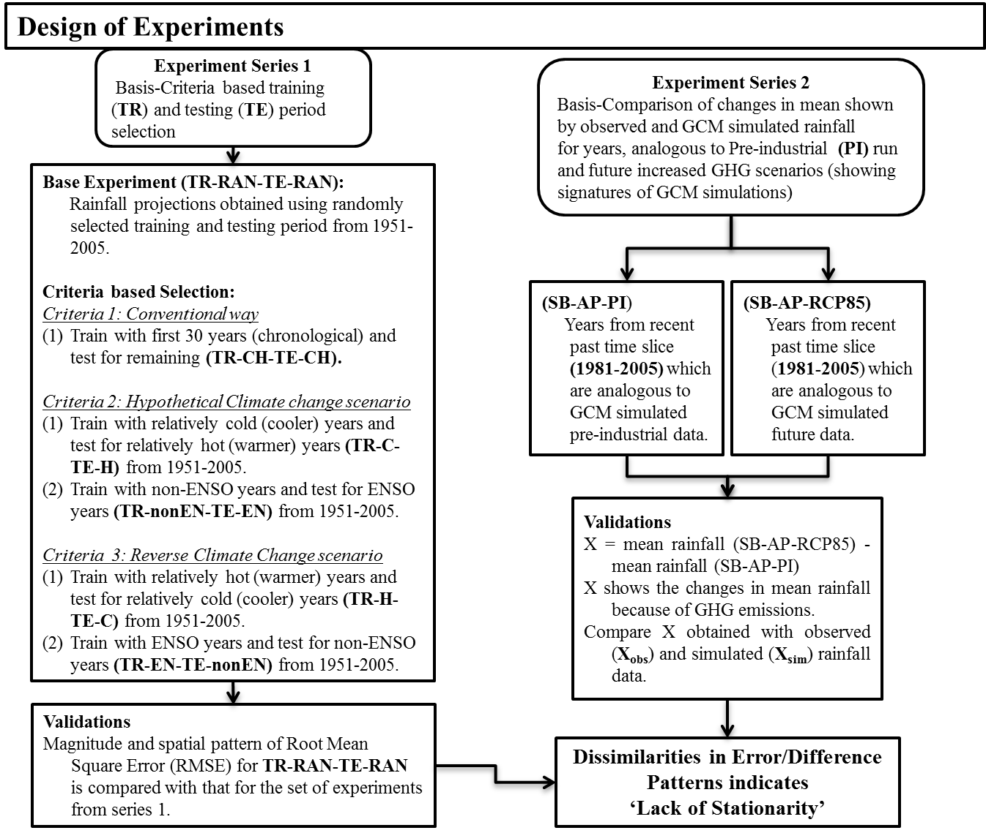
Do they work in non-stationary climate?

Slide 12
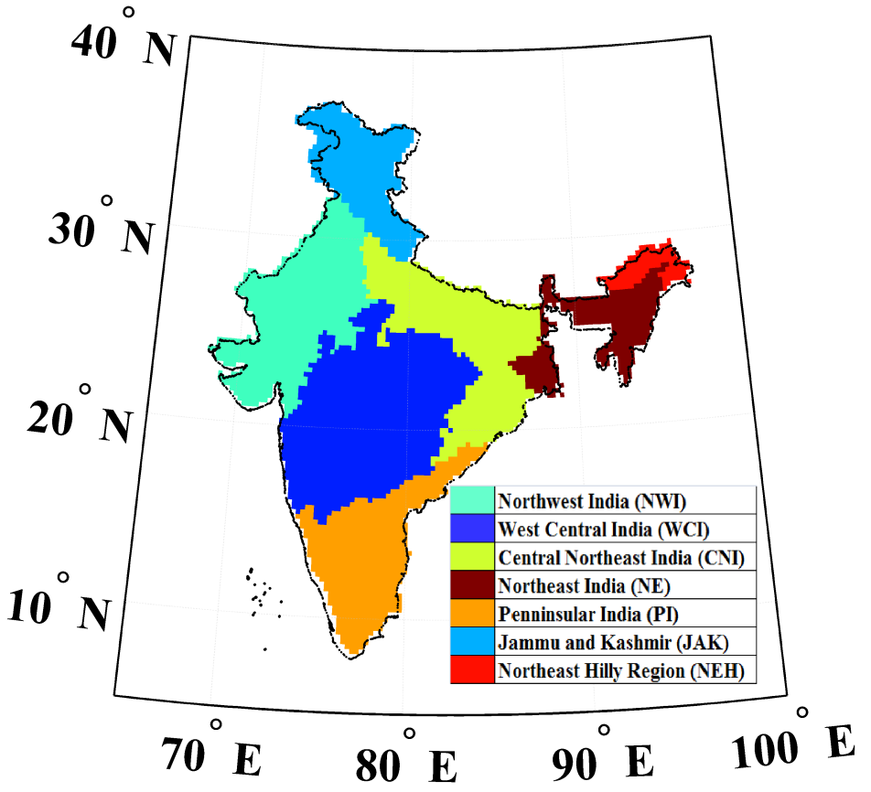
Study Regions: To illustrate the generic nature of methodology
Study Region 1: India
Study Region 2: Northeast US
(a)
(b)
27
Notes:
Figure 11: Relationship between orography and changes in mean rainfall for India
Figure 11(a): Physical map of India (source: Survey of India)
Figure 11(b): Projected mean rainfall of India (20C3M). Black arrows show direction of SASM (Arabian sea branch). Black filled triangles show approximate alignment of Western Ghats, Pink filled triangles show the approximate alignment of Satpura range, black empty triangles show approximate alignment of Aravali range. Pink arrows show direction of SASM (Bay of Bengal branch).

Slide 13
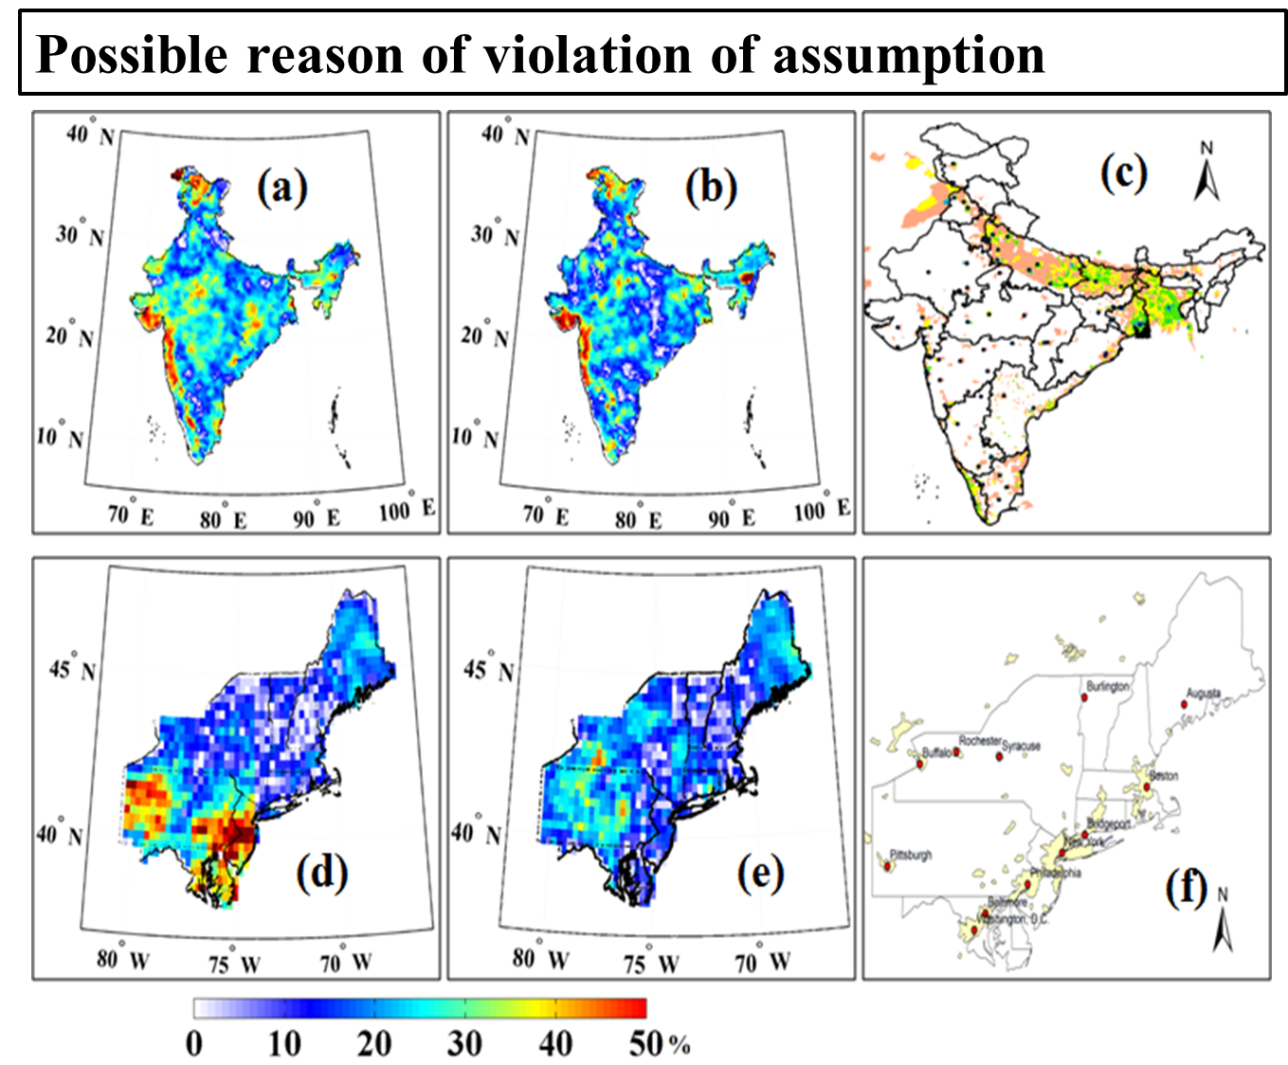
Violation on Non-stationarity
Salvi et al., 2016, Clim Dyn

Slide 14

Do they provide any signal of changes?
Shashikanth et al. (2014)
Jl. of Hydrology

Slide 15
Assessing Hydrological Impacts

Slide 16
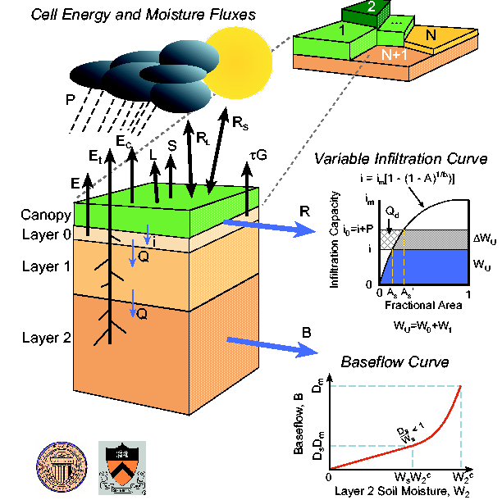
Variable Infiltration Capacity Model

Slide 17
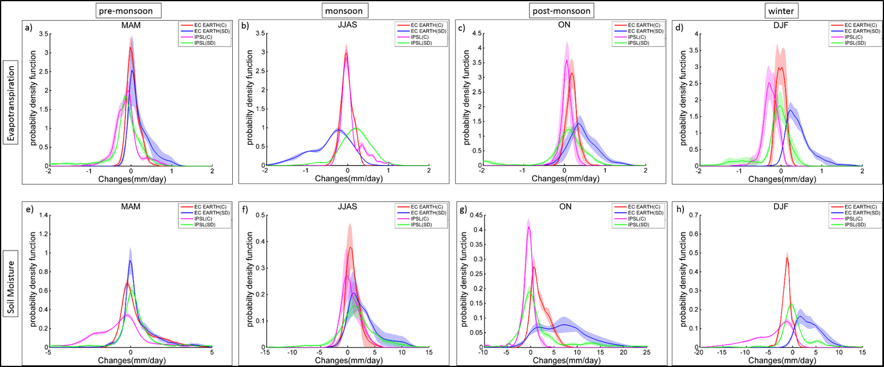
Hydrological Parameterization in the background of Climate Uncertainty
Given the climate uncertainty, you may not even require any hydrological parameterization? ☺
Joseph et al. (2016), Revised manuscript under preparation for JH

Slide 18
Hydrological Parameter Calibration lost its value? ☺

Slide 19
Land Surface Feedback
Pathak et al. (2016),
JHM and Jl of Climate

Slide 20
LULC Changes in India

Slide 21
Impacts of LULC: Changes Partially Consistent with Observed Changes

Slide 22
Processes
Paul et al. (2016), Scientific Reports (Nature Publishing Group)

Slide 23
Open Questions
We use the word “Uncertainty”, but are we really “Confident” enough in providing regional projections with different changing sign and magnitudes to water resources managers for developing adaptation strategies?
Shouldn’t we consider feedback from regional LULC changes and growing urbanization?
We are worried about ‘stationarity’ in statistical downscaling relationship; but with a high bias in Dynamic downscaling, we have to use bias correction… are regional biases stationary?

Slide 24
Thank you

